Slide 1
PALESTINE ELECTRICITY INVOICE
MANAGEMENT SYSTEM
👨‍💻 Developed by: Ali Odeh
🏢 Company: Harri
📅 Date: 29/10/2025

Slide 2
Project Overview
The Electricity Invoice Management System is an enterprise-level web application designed to streamline and automate electricity invoice management for multiple providers and customers.
The system simplifies the process of:
Creating and managing invoices
Handling dynamic electricity pricing per provider
Tracking the history of every change
Providing real-time visibility and control
It aims to increase accuracy, reduce errors, and give each role the exact tools they need.

Slide 3
Main Objectives
Centralized Management – Unified platform for all electricity invoices across multiple providers
Role-Based Security – Strict access control ensuring data protection and compliance
Automated Tracking – Complete invoice lifecycle management from creation to payment
Pricing Transparency – Comprehensive historical tracking of all rate changes
Advanced Auditing – AI-powered analytics with natural language queries
Multi-Provider Support – Scalable architecture with complete data isolation

Slide 4
User Roles & Permissions
Normal User (Customer)
Can log in securely using their credentials.
Can view and track only their own invoices.
Cannot create, edit, or delete any invoice data.
Invoice Creator
Create invoices for customers within their assigned provider.
Edit only the invoices they personally created.
Responsible for ensuring accuracy in invoice details.
Super Invoice Creator
Has all the permissions of an Invoice Creator.
Edit and manage any invoice created under the same provider.
Acts as a supervisor for invoice operations within their provider.

Slide 5
User Roles & Permissions - cont.
Auditor
Has read-only access to all invoices within their assigned provider.
View the full change history of any invoice.
Ask natural language questions about invoices and data through the AI-powered query system.
Ensures compliance and transparency in billing operations.
Administrator
Full system control and configuration access.
register new customers and manage user accounts.
add new electricity providers.
change/update the kWh price for any provider.
Oversees and maintains the entire platform.
Can assign one or multiple roles to any user and fully manage all roles across the system.

Slide 6
Technology Stack
Frontend: Html, Css, Js
Backend: Spring Boot 3 + Java 21
Database Layer: MySQL 8 with Spring Data JPA/Hibernate
Security: JWT Authentication + Spring Security
AI Integration: Google Gemini API (Text-to-SQL)
Documentation: Swagger / OpenAPI
Build Tool: Maven
Architecture:
Layered design: Controller → Service → Repository → Entity
The system implements RESTful API standards for all operations, ensuring scalability and maintainability.

Slide 7
Core Features
Authentication & Security
JWT-based authentication with expiration
Role-based access control (RBAC)
Password encryption
CORS & token validation
Data isolation between providers
SQL injection protection and input validation
Invoice Management
Automated calculations: Total = kWh × Price
Payment statuses: Pending, Paid, Overdue, Cancelled
Comprehensive tracking and history
Search by invoice number
Provider Management
Manage multiple electricity providers
Dynamic pricing updates with history tracking
Pricing History
Historical accuracy with valid_from/valid_to dates
Every price change is recorded with:
- Old value, New value, Who changed it, When
Invoices always reflect the correct historical price
Audit System
Automatic logging of all invoice operations
Complete before/after snapshots in JSON
Track who performed each action and when
Search capabilities by invoice number
AI-Powered Analytics
Natural language query processing with Google Gemini
Only SELECT queries allowed
Convert plain English questions to SQL
Secure, provider-scoped execution
Maximum 100-row result limits

Slide 8
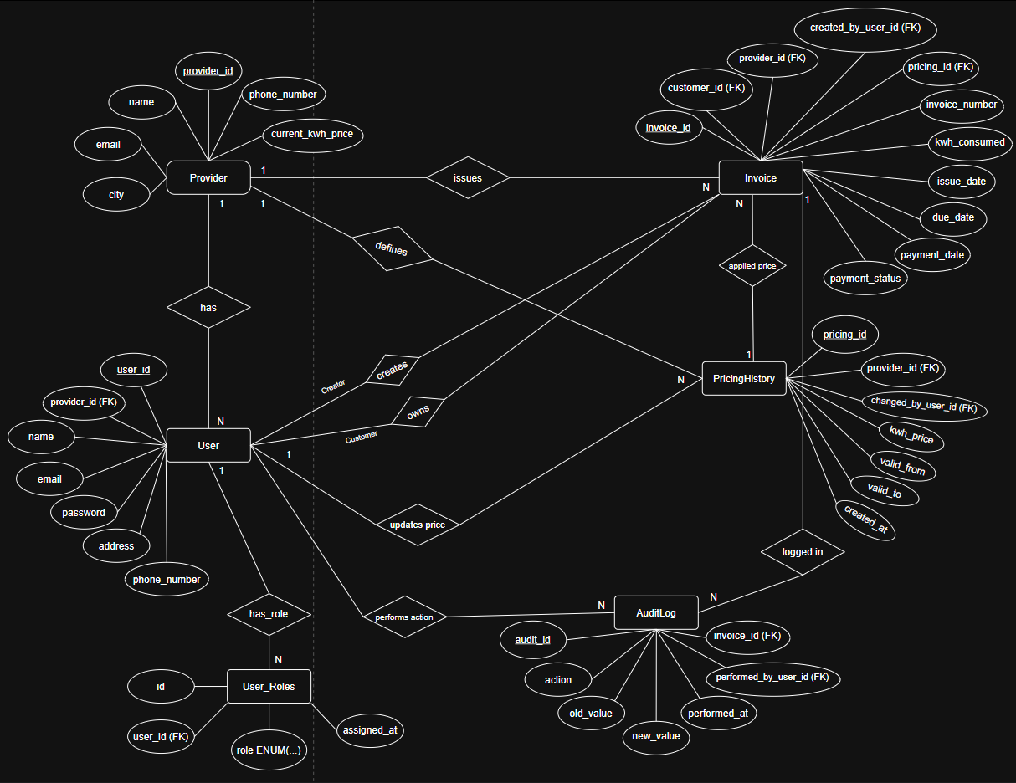
ERD ➜

Slide 9
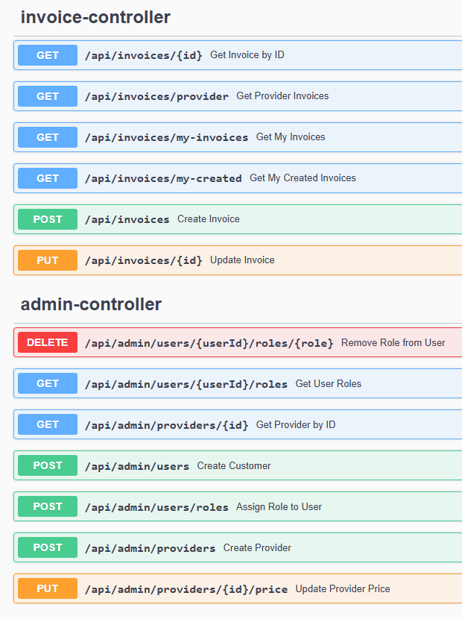
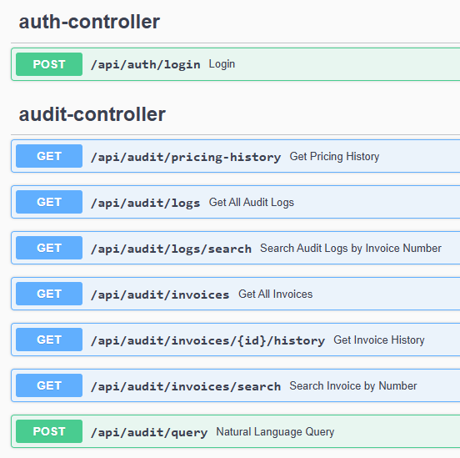
RESTful API Endpoints

